Slide 1
Unit 4
7.1: Variable Notation
7.2: Solving Linear Equations
7.3: Linear Equations with Fractions and Decimals
7.4: Solving Linear Equations with Fractions and Decimals by Clearing the Denominators
7.5: Formulas

Slide 2
Steps to Solve Equations
Clear Fractions
Get Rid of ( )
Combine Like Terms:
Same Side of =
Combine Like Terms:
Opposite Side of =
Addition Property
Solve for Variable
Multiplication Property
+ ↔ -
x ↔÷

Slide 3
Equations with Decimals
Equations that contain fractions can be solved using the same steps.
OPTIONAL: Clear decimals first

Slide 4


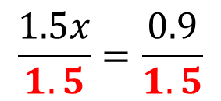


Steps for Solving a Linear Equation
Clear Fractions
Get Rid of ( )
Combine Like Terms:
Same Side of =
Combine Like Terms:
Opposite Side of =
Addition Property
Solve for Variable
Multiplication Property
$$1.5x+2.1=3$$
$$1.5x+2.1−2.1=3−2.1$$
$$1.5x=0.9$$
$$\frac{1.5x}{1.5}=\frac{0.9}{1.5}$$
$$x=0.6$$

Slide 5
Equations with Fractions
Equations that contain fractions can be solved using the same steps ... as long as they are “simple” fractions.
Example: No variables in a denominator.

Slide 6
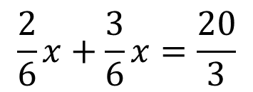
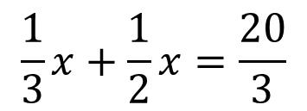

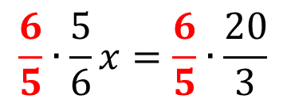
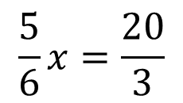
Steps for Solving a Linear Equation
$$\frac{1}{3}x+\frac{1}{2}x=\frac{20}{3}$$
Clear Fractions
Get Rid of ( )
Combine Like Terms:
Same Side of =
Combine Like Terms:
Opposite Side of =
Addition Property
Solve for Variable
Multiplication Property
$$\frac{2}{6}x+\frac{3}{6}x=\frac{20}{3}$$
$$\frac{5}{6}x=\frac{20}{3}$$
$$\frac{6}{5}∙\frac{5}{6}x=\frac{6}{5}∙\frac{20}{3}$$
$$x=8$$

Slide 7
Equations with Fractions
The process of clearing fractions(decimals) involves multiplying every term in an equation by the least common denominator of the terms in the equation.
Clearing fractions simplifies the computations in solving an equation with fractions and removes any variables from the denominators of the terms.

Slide 8


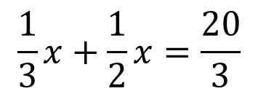

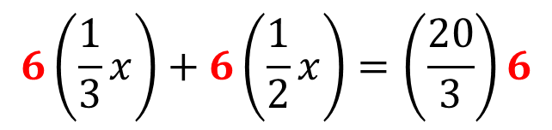
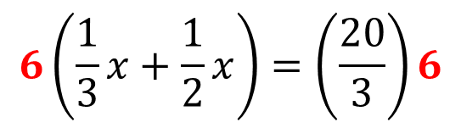
Steps for Solving a Linear Equation
$$\frac{1}{3}x+\frac{1}{2}x=\frac{20}{3}$$
Clear Fractions
Get Rid of ( )
Combine Like Terms:
Same Side of =
Combine Like Terms:
Opposite Side of =
Addition Property
Solve for Variable
Multiplication Property
$$6\left(\frac{1}{3}x+\frac{1}{2}x\right)=\left(\frac{20}{3}\right)6$$
2
3
2
$$6\left(\frac{1}{3}x\right)+6\left(\frac{1}{2}x\right)=\left(\frac{20}{3}\right)6$$
$$2x+3x=40$$
$$5x=40$$
$$x=8$$

Slide 9
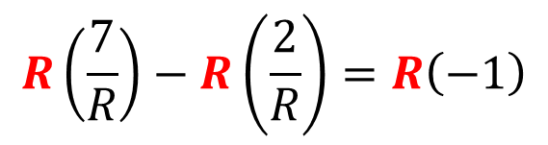

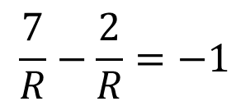


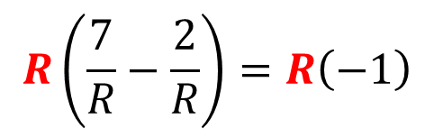
Steps for Solving a Linear Equation
$$\frac{7}{R}−\frac{2}{R}=−1$$
Clear Fractions
Get Rid of ( )
Combine Like Terms:
Same Side of =
Combine Like Terms:
Opposite Side of =
Addition Property
Solve for Variable
Multiplication Property
$$R\left(\frac{7}{R}−\frac{2}{R}\right)=R\left(−1\right)$$
$$R\left(\frac{7}{R}\right)−R\left(\frac{2}{R}\right)=R\left(−1\right)$$
$$7−2=−R$$
$$5=−R$$
$$−5=R$$

Slide 10


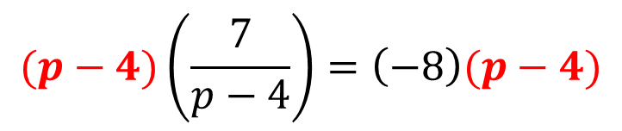
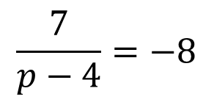


Steps for Solving a Linear Equation
$$\frac{7}{p−4}=−8$$
Clear Fractions
Get Rid of ( )
Combine Like Terms:
Same Side of =
Combine Like Terms:
Opposite Side of =
Addition Property
Solve for Variable
Multiplication Property
$$(p−4)\left(\frac{7}{p−4}\right)=\left(−8\right)(p−4)$$
$$7=−8(p−4)$$
$$7=−8p+32$$
$$−25=−8p$$
$$\frac{25}{8}=p$$

Slide 11
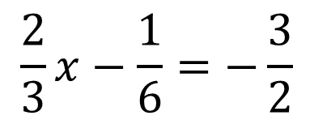
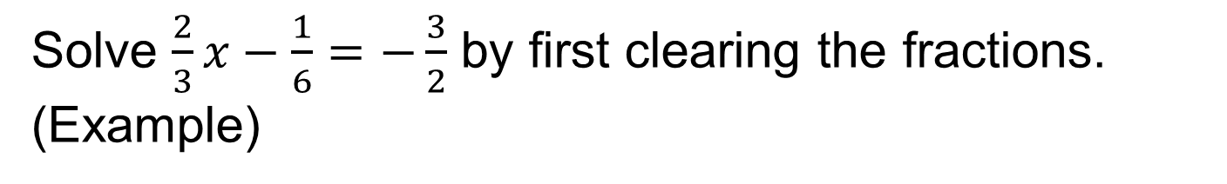
Equations with Fractions/Decimals
Solve $\frac{2}{3}x−\frac{1}{6}=−\frac{3}{2}$ by first clearing the fractions. (Example)
$$\frac{2}{3}x−\frac{1}{6}=−\frac{3}{2}$$
The LCM of 3, 6 and 2 is 6.

Slide 12
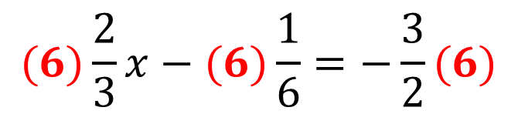



Equations with Fractions/Decimals
Solve $\frac{2}{3}x−\frac{1}{6}=−\frac{3}{2}$ by first clearing the fractions. (Example)
2
1
3
$$(6)\frac{2}{3}x−(6)\frac{1}{6}=−\frac{3}{2}(6)$$
$$4x−1=−9$$
$$4x=−8$$
$$x=−2$$

Slide 13
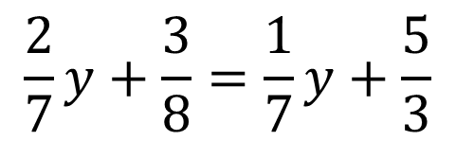
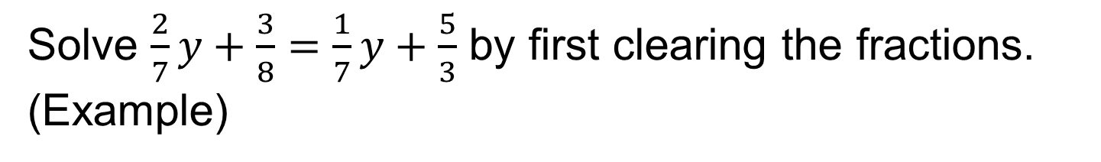
Equations with Fractions/Decimals
Solve $\frac{2}{7}y+\frac{3}{8}=\frac{1}{7}y+\frac{5}{3}$ by first clearing the fractions. (Example)
$$\frac{2}{7}y+\frac{3}{8}=\frac{1}{7}y+\frac{5}{3}$$
The LCM of 7, 8 and 3 is 168.

Slide 14
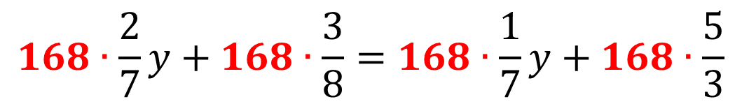
Equations with Fractions/Decimals
Solve $\frac{2}{7}y+\frac{3}{8}=\frac{1}{7}y+\frac{5}{3}$ by first clearing the fractions. (Example)
$$168∙\frac{2}{7}y+168∙\frac{3}{8}=168∙\frac{1}{7}y+168∙\frac{5}{3}$$

Slide 15
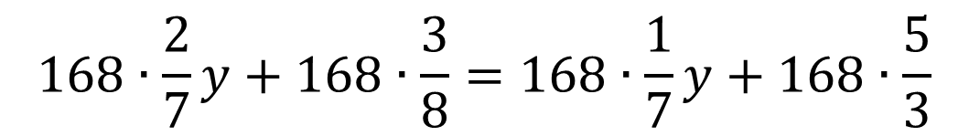
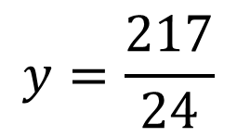


Equations with Fractions/Decimals
Solve $\frac{2}{7}y+\frac{3}{8}=\frac{1}{7}y+\frac{5}{3}$ by first clearing the fractions. (Example)
$$168∙\frac{2}{7}y+168∙\frac{3}{8}=168∙\frac{1}{7}y+168∙\frac{5}{3}$$
$$48y+63=24y+280$$
$$24y=217$$
$$y=\frac{217}{24}$$

Slide 16
Extraneous Roots
Extraneous roots are values derived from solving an equation with variables in the denominator of a term that make the equation a false statement when replaced into the original equation.
Always check your solutions in the original equation to eliminate extraneous roots.

Slide 17
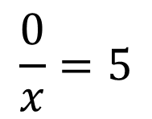
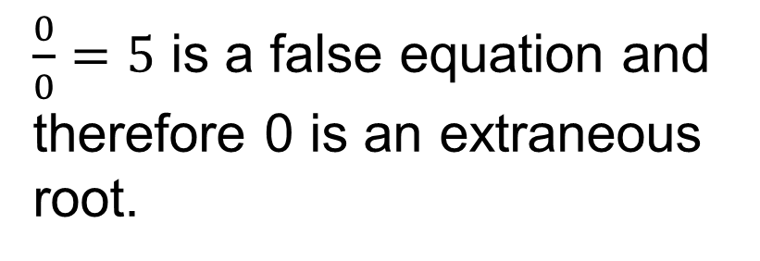


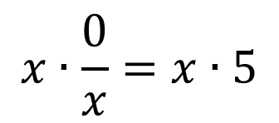
Extraneous Roots
Solve $\frac{0}{x}=5$ (Example)
$$\frac{0}{x}=5$$
$$0=5x$$
$$0=x$$
$$x∙\frac{0}{x}=x∙5$$
$\frac{0}{0}=5$ is a false equation and therefore 0 is an extraneous root.

Slide 18
Problems Involving Work
The following equations are used to set up and solve problems involving the completion of a job.
$$Amount of work completed=(rate of work)(time worked)$$
$$\left(A^{′}s amount of work\right)+\left(B^{′}s amount of work\right)=1 completed job$$
$$\left(A^{′}s amount of work\right)−\left(B^{′}s amount of work\right)=1 completed job$$

Slide 19
Problems Involving Work
Pipe 1 fills a tank in 6 min and pipe 2 fills the same tank in 8 min. How long does it take the pipes to fill the tank when working together. (Example)
$$\left(A^{′}s amount of work\right)+\left(B^{′}s amount of work\right)=1 completed job$$

Slide 20
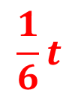
Problems Involving Work
Pipe 1 fills a tank in 6 min and pipe 2 fills the same tank in 8 min. How long does it take the pipes to fill the tank when working together. (Example)
$$\left(A^{′}s amount of work\right)+\left(B^{′}s amount of work\right)=1 completed job$$
$$\frac{1}{6}t$$

Slide 21
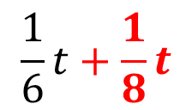
Problems Involving Work
Pipe 1 fills a tank in 6 min and pipe 2 fills the same tank in 8 min. How long does it take the pipes to fill the tank when working together. (Example)
$$\left(A^{′}s amount of work\right)+\left(B^{′}s amount of work\right)=1 completed job$$
$$\frac{1}{6}t+\frac{1}{8}t$$

Slide 22
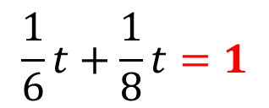
Problems Involving Work
Pipe 1 fills a tank in 6 min and pipe 2 fills the same tank in 8 min. How long does it take the pipes to fill the tank when working together. (Example)
$$\left(A^{′}s amount of work\right)+\left(B^{′}s amount of work\right)=1 completed job$$
$$\frac{1}{6}t+\frac{1}{8}t=1$$

Slide 23
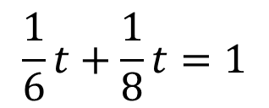
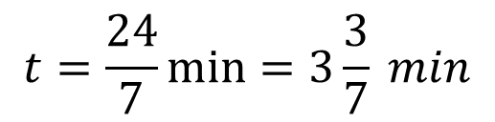


Problems Involving Work
Pipe 1 fills a tank in 6 min and pipe 2 fills the same tank in 8 min. How long does it take the pipes to fill the tank when working together. (Example)
$$\left(A^{′}s amount of work\right)+\left(B^{′}s amount of work\right)=1 completed job$$
$$7t=24$$
$$\frac{1}{6}t+\frac{1}{8}t=1$$
$$t=\frac{24}{7}\min{=3\frac{3}{7} min}$$
$$4t+3t=24$$

Slide 24
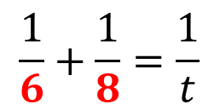

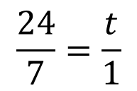
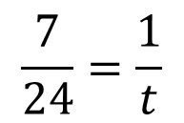
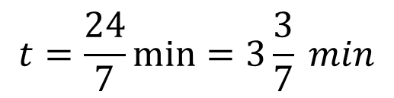
Problems Involving Work
Pipe 1 fills a tank in 6 min and pipe 2 fills the same tank in 8 min. How long does it take the pipes to fill the tank when working together. (Example)
$$SHORTCUT:$$
$$\frac{1}{6}+\frac{1}{8}=\frac{1}{t}$$
$$\frac{7}{24}=\frac{1}{t}$$
$$\frac{24}{7}=\frac{t}{1}$$
$$t=\frac{24}{7}\min{=3\frac{3}{7} min}$$

Slide 25
Problems Involving Work
A faucet fills a tank in 6 min. A drain empties the tank in 8 min. If both the facet and drain are open, in how many minutes will the tank start to overflow. (Example)
$$\left(A^{′}s amount of work\right)−\left(B^{′}s amount of work\right)=1 completed job$$

Slide 26
Problems Involving Work
A faucet fills a tank in 6 min. A drain empties the tank in 8 min. If both the facet and drain are open, in how many minutes will the tank start to overflow. (Example)
$$\left(A^{′}s amount of work\right)−\left(B^{′}s amount of work\right)=1 completed job$$
$$\frac{1}{6}t$$

Slide 27
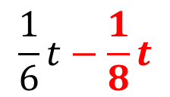
Problems Involving Work
A faucet fills a tank in 6 min. A drain empties the tank in 8 min. If both the facet and drain are open, in how many minutes will the tank start to overflow. (Example)
$$\left(A^{′}s amount of work\right)−\left(B^{′}s amount of work\right)=1 completed job$$
$$\frac{1}{6}t−\frac{1}{8}t$$

Slide 28
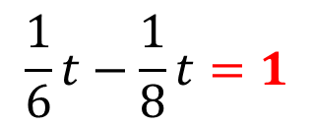
Problems Involving Work
A faucet fills a tank in 6 min. A drain empties the tank in 8 min. If both the facet and drain are open, in how many minutes will the tank start to overflow. (Example)
$$\left(A^{′}s amount of work\right)−\left(B^{′}s amount of work\right)=1 completed job$$
$$\frac{1}{6}t−\frac{1}{8}t=1$$

Slide 29
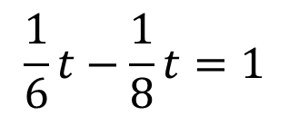


Problems Involving Work
A faucet fills a tank in 6 min. A drain empties the tank in 8 min. If both the facet and drain are open, in how many minutes will the tank start to overflow. (Example)
$$\left(A^{′}s amount of work\right)−\left(B^{′}s amount of work\right)=1 completed job$$
$$\frac{1}{6}t−\frac{1}{8}t=1$$
$$t=24 min$$
$$4t−3t=24$$

Slide 30
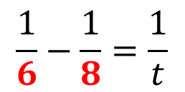

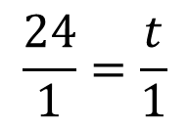
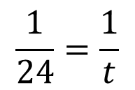
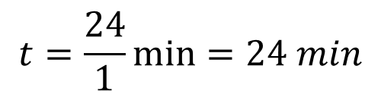
Problems Involving Work
A faucet fills a tank in 6 min. A drain empties the tank in 8 min. If both the facet and drain are open, in how many minutes will the tank start to overflow. (Example)
$$SHORTCUT:$$
$$\frac{1}{6}−\frac{1}{8}=\frac{1}{t}$$
$$\frac{1}{24}=\frac{1}{t}$$
$$\frac{24}{1}=\frac{t}{1}$$
$$t=\frac{24}{1}\min{=24 min}$$

